Slide 1

Medicine Information System
By, Group 1
Choudhury Ben Yamin Siddiqui
Iliyas Ahmed Robin
Md. Rabiul Hasan
Sabbi Arrafta Sahib
Sihab Saharier
Sadat Kabir Shafin

Slide 2
Introduction
Medicine Information System (MIS) is a web application made to give pharmacies an easier time with their sales.
It makes records for inventory, sales and others

Slide 3
Benefits
Enhanced Medicine management, leading to fewer errors
Increased efficiency
Cost Saving

Slide 4
Challenges
System Implementation
User Adoption and Training
Increase in Administrative Burden

Slide 5
Technical Details
Front-End : HTML, JavaScript, CSS
Back-End : PHP
Database : MySQL

Slide 6
Development Cycle
Initialization
Requirement Gathering And Analysis
System Design
Development
Testing
Deployment
Evaluation/Feedback

Slide 7
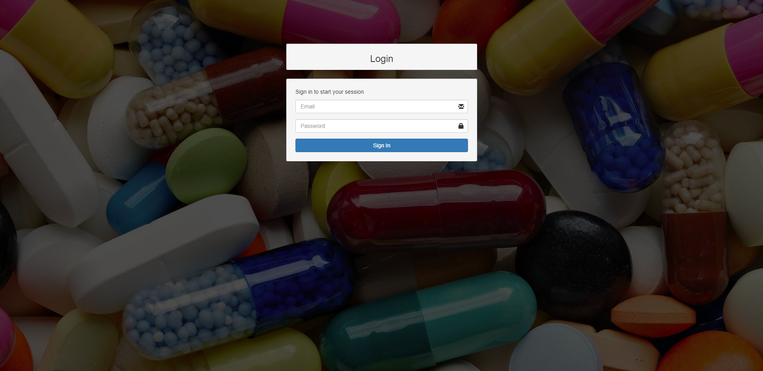
Login Page

Slide 8
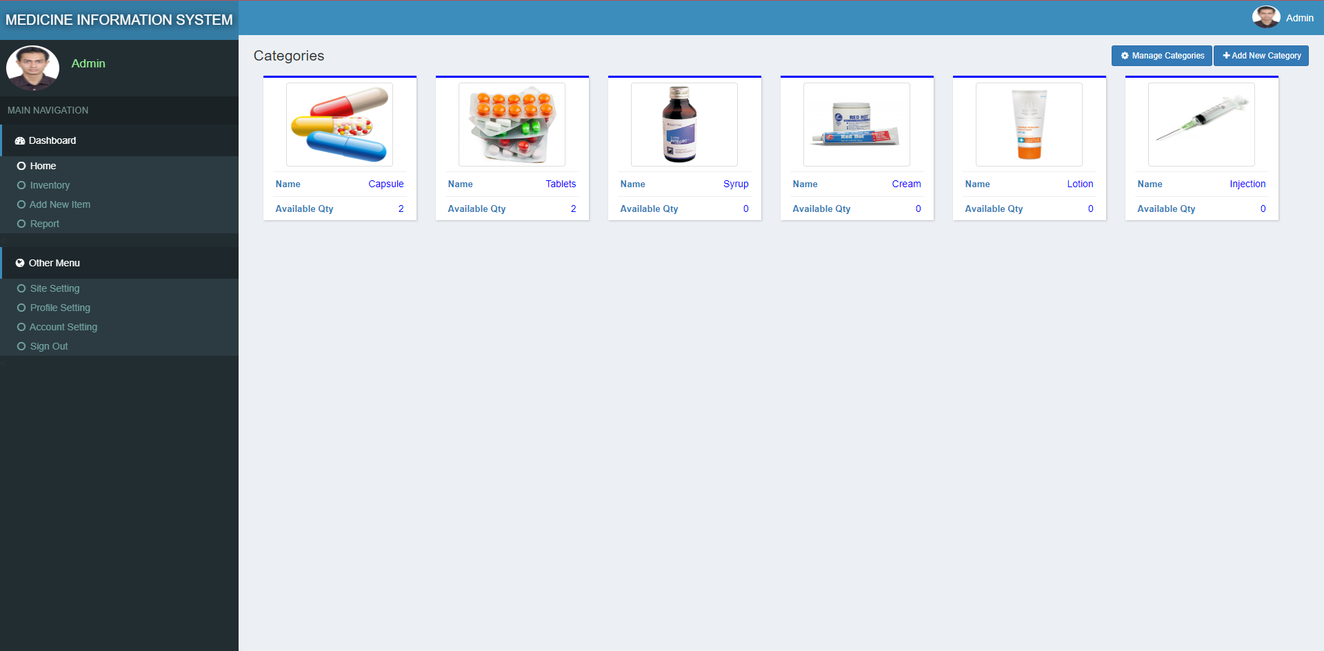
Dashboard

Slide 9
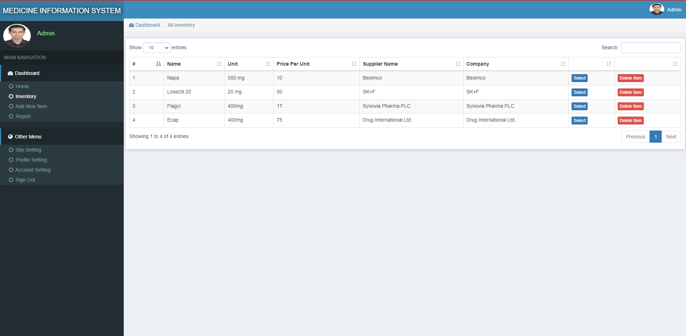
Inventory

Slide 10
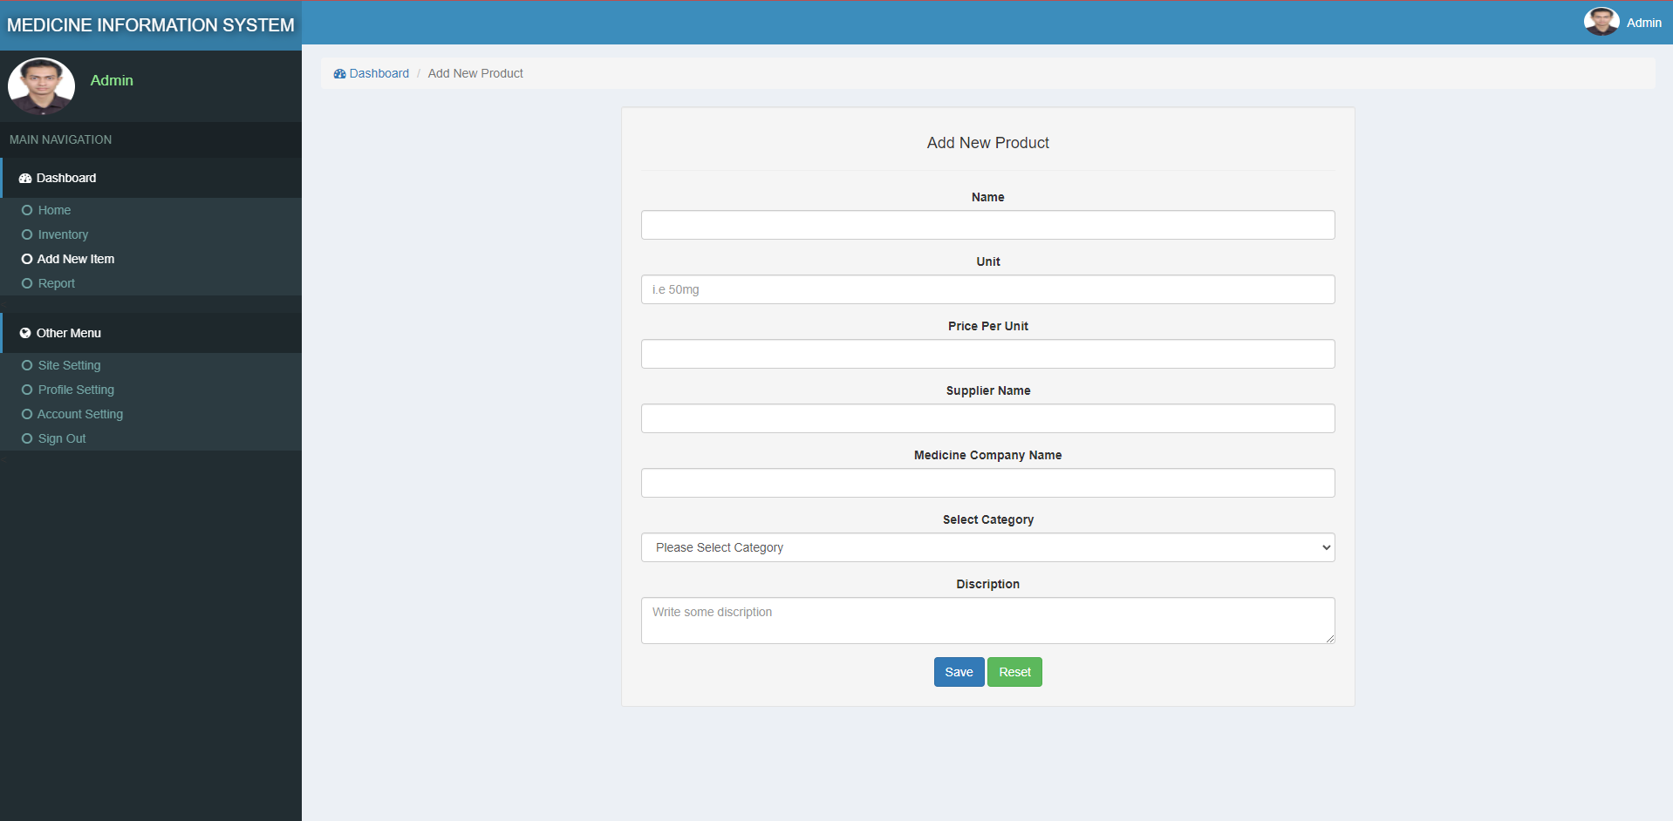
Add New Item

Slide 11
Future Possibilities
Implementation of AI and ML
Personalized Medicine

Slide 12
Thank you

